Slide 1
Problem solving using Java – CSE1006
[L-T-P-C: 1-0-4-3]
MODULE – 4
Abstract classes, Abstract methods & Interface
[Lecture:3 & Practical:14]
Mr. R C Ravindranath, Asst. Prof, SOE-CSE
Notes:
Mr. R C Ravindranath, Asst. Prof., SOE-CSE

Slide 2
final keyword:
final can be used in following contexts
1) final variables
If a variable is declared with the final keyword, its value cannot be changed once initialized.
Example: final double PI = 314159; //PI is a constant
final int max=10;
2) final method: When a method is declared as final, it cannot be overridden by a subclass.
class A
{
final void m1() // final method
{
System.out.println(“This is a final method.”);
}
}
class B extends A {
void m1()
{
// Compile-error! We can not override
System.out.println(“Illegal!”);
}
}

Slide 3
3) final class: When a class is declared as final, it cannot be extended by a subclass.
final class A
{
// methods and fields
}
// The following class is illegal
class B extends A // can’t be extended, because parent is final class
{
// COMPILE-ERROR! Can’t subclass A
}

Slide 4
abstract: It is a non-access modifier in java, abstract is applicable for classes, and methods but not variables.
It is used to achieve abstraction which is one of the key feature of Object Oriented Programming(OOP).
Abstract method :
An abstract method does not have a implementation (body).
Child classes are responsible to provide implementation (body) for parent class abstract methods, otherwise they are abstract themselves.
Syntax to declare an abstract method is :
abstract returnType methodName(parameters);
Note: It ends with a semicolon.
We cannot create objects (instantiation) for the abstract classes, because they are incomplete classes.
Note : If a class contain at least on abstract method then compulsory the corresponding class should be declared with abstract modifier. Because implementation is not completed and hence we can’t create object of that class.

Slide 5
Abstract class:
An abstract class in Java is a class that cannot be instantiated on its own and
may contain abstract methods (methods without a body) as well as concrete methods (with implementation).
It's used as a base class to define common behavior and force subclasses to implement specific methods.
Example:
abstract class Test
{
public static void main(String args []){
Test t1=new Test(); // we can not create object (instantiation)
}}
Output:
Compile time error.
Note: Instantiation is the process of creating an object from a class using the new keyword.

Slide 6
Interface :
A Java interface contains static constants and abstract methods.
An Interface is defined as an abstract type used to specify the behaviour of a class. An interface in Java is a blueprint of a behaviour.
Key points:
The interface in Java is a mechanism to achieve abstraction.
By default, variables in an interface are public, static, and final.
It is used to achieve abstraction and multiple inheritance in Java.
interfaces primarily define methods that other classes must implement.
No constructors allowed.
Syntax to declare interface is:
interface InterfaceName {
type final varname1 = value; // public static final by default
type final varname2 = value;
return-type method-name1(parameter-list); // public abstract by default
return-type method-name2(parameter-list);
}

Slide 7
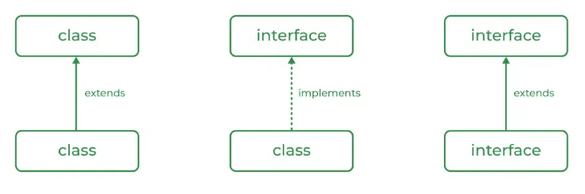
Relation between class and interface :
A class can extend another class, and similarly, an interface can extend another interface. However, only a class can implement an interface, and the reverse (an interface implementing a class) is not allowed.

Slide 8
